Slide 1
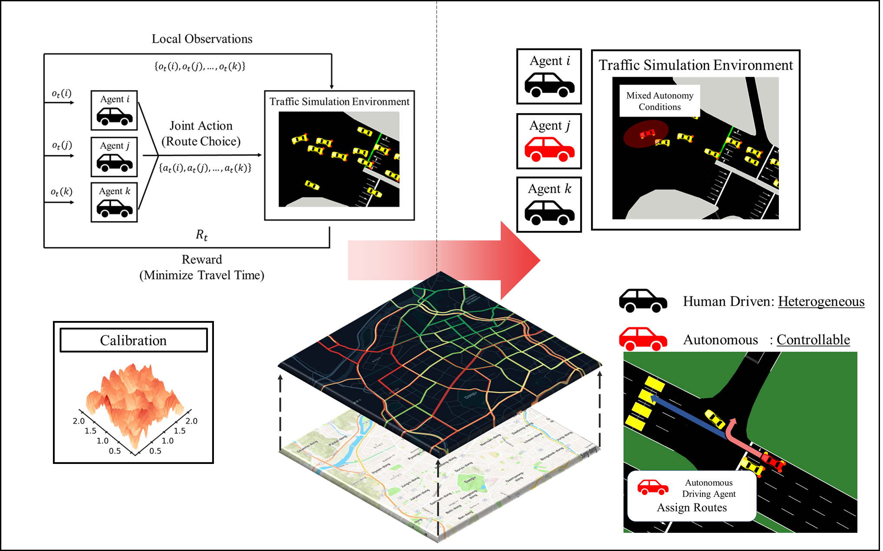
A Multi-agent Reinforcement Learning Approach of Dynamic Traffic Assignment
What is the problem?
As a modeling process, the goal of dynamic traffic assignment (DTA) is to determine the network traffic flows and conditions that result from the mutual interactions among the route
Traffic Assignment models make several irrational assumptions, regarding how traveler route choice behavior is modeled and how traffic flows and conditions are represented
Traffic networks are usually stochastic and time dependent due to the nature of periodicity and volatility of traffic demand (Congestions, Spillbacks) which makes DTA challenging.
Why is this problem important?
It is necessary to model system’s equilibrating processes to prevent congestion, manage the traffic network
The developed DTA model can be used to analyze indicators relating to individual travel time and cost, as well as systemwide network measurements for transportation planning.
How can we solve this problem?
Multi-agent reinforcement learning (MARL) can depict competitive route choice behaviors
Compose Concepts of DTA with MARL framework
A model for how congestion varies over time → Model Free Simulator (SUMO)
A concept of equilibrium route choice → MARL Framework of Competitive Route choice
Equilibration based on experienced travel times → Varying degree of observations + MARL Framework
What is key contribution?
Proposed MARL framework can depict real world route choice behaviors
Suggested framework can be used as calibrators between real world and microscopic simulations

